Slide 1

Example 24.1
Figure 24.8 shows how to define INTEGER 14. Note that we have used both binary representation and hexadecimal representation for the tag. The size of the length field is from Table 24.1.

Slide 2
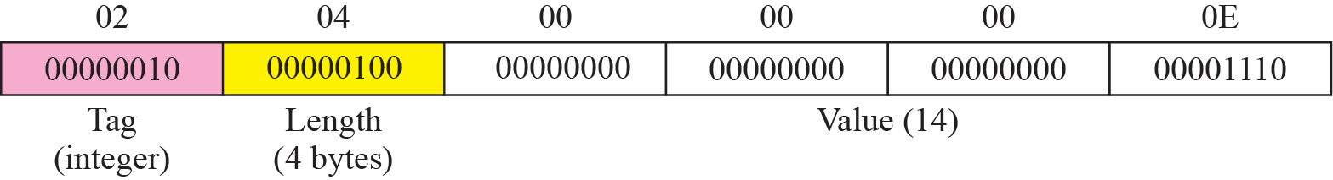
Figure 24.8 Example 24.1: INTEGER 14

Slide 3
Example 24.2
Figure 24.9 shows how to define the OCTET STRING “HI.”

Slide 4
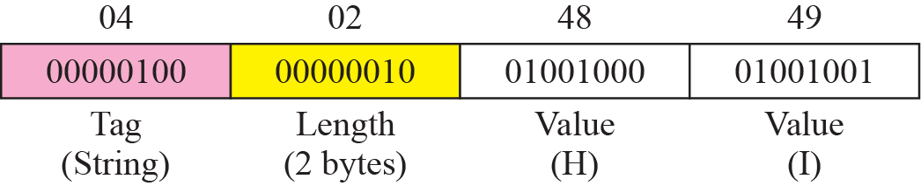
Figure 24.9 Example 24.2: OCTET STRING “HI”

Slide 5
Example 24.3
Figure 24.10 shows how to define ObjectIdentifier 1.3.6.1 (iso.org.dod.internet).

Slide 6
24-4 MIB
The Management Information Base, version 2 (MIB2) is the second component used in network management. Each agent has its own MIB2, which is a collection of all the objects that the manager can manage. The objects in MIB2 are categorized under 10 different groups: system, interface, address translation, ip, icmp, tcp, udp, egp, transmission, and snmp. These groups are under the mib-2 object in the object identifier tree (see Figure 24.12). Each group has defined variables and/or tables.

Slide 7
Topics Discussed in the Section
Accessing MIB Variables
Lexicographic Ordering

Slide 8
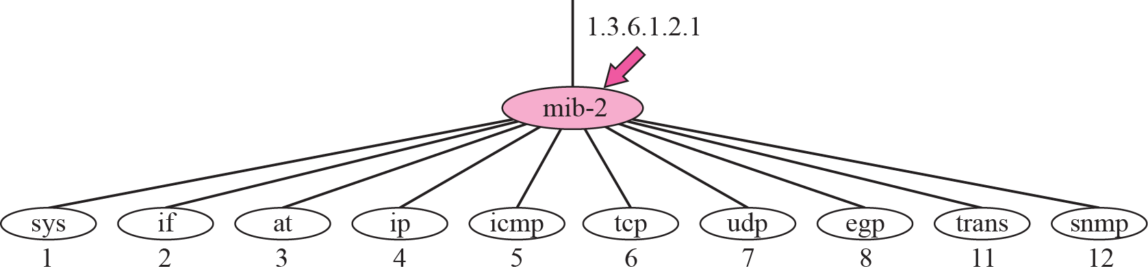
Figure 24.12 mib-2

Slide 9
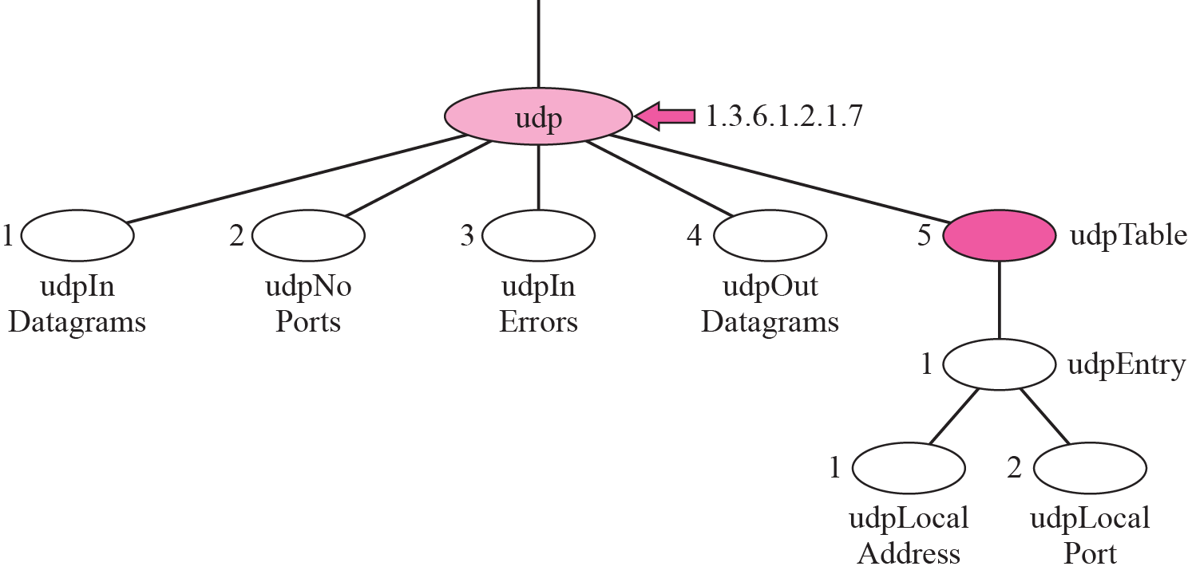
Figure 24.13 udp group

Slide 10
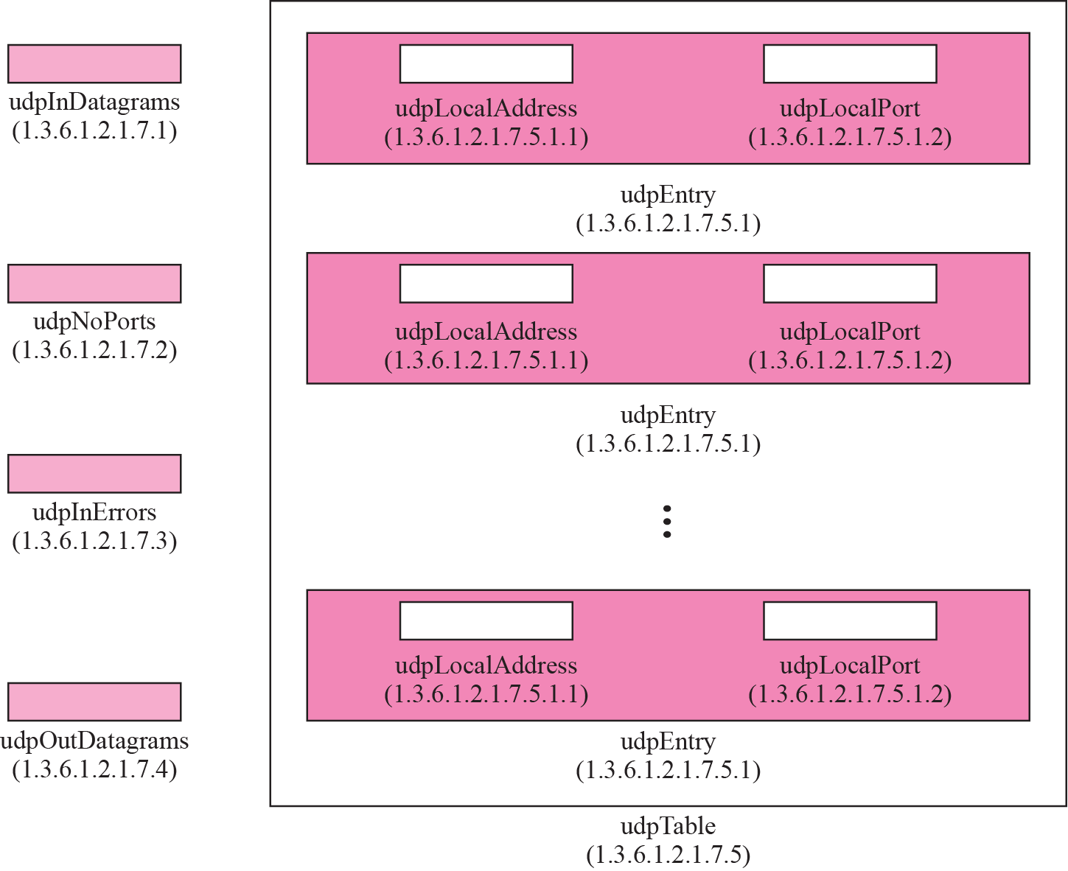
Figure 24.14 udp variables and tables

Slide 11
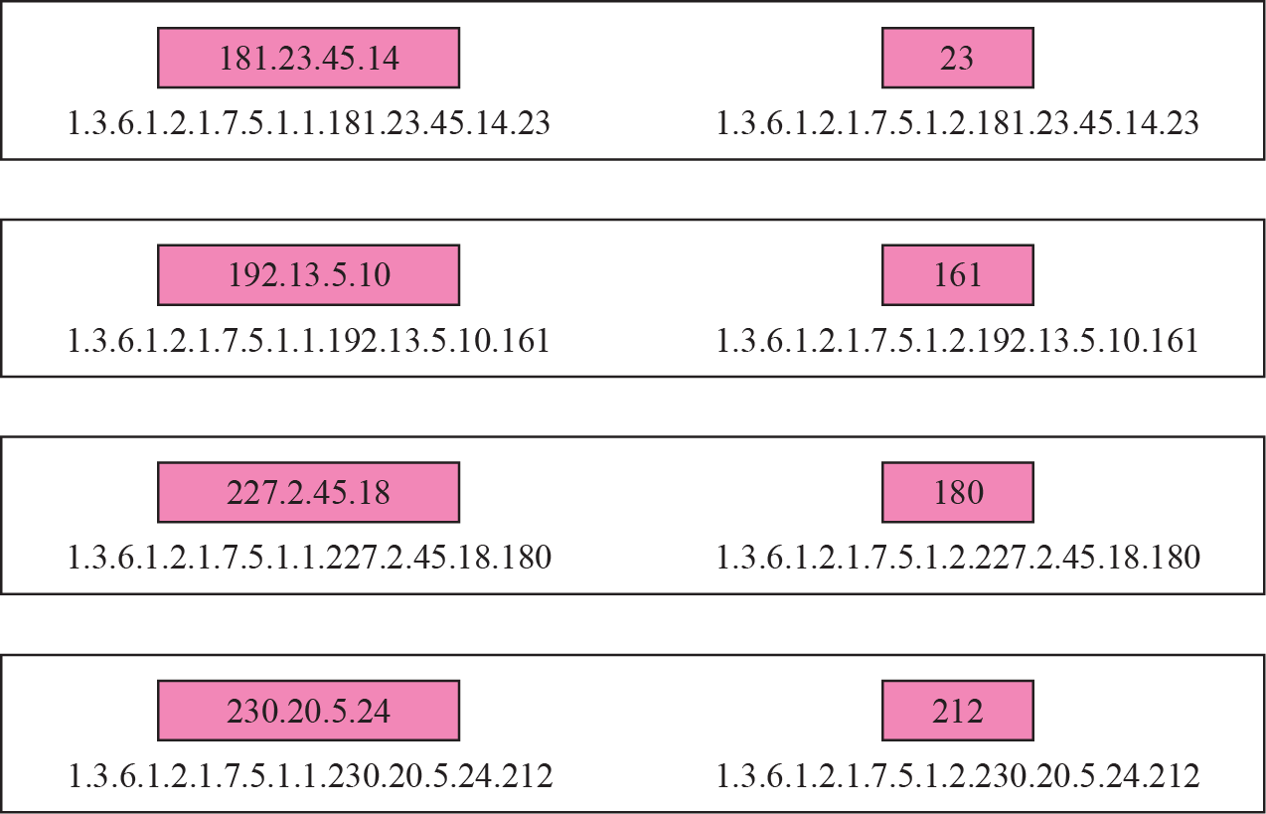
Figure 24.15 Indexes for udpTable

Slide 12
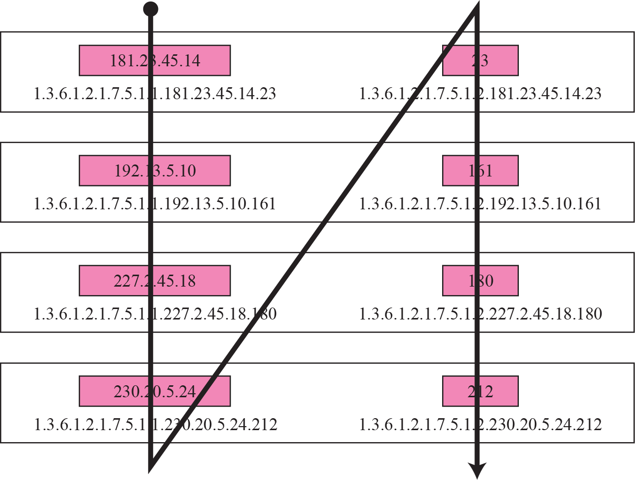
Figure 24.16 Lexicographic ordering

Slide 13
24-5 SNMP
SNMP uses both SMI and MIB in Internet network management. It is an application program that allows:
1. A manager to retrieve the value of an object defined in an agent.
2. A manager to store a value in an object defined in an agent.
3. An agent to send an alarm message about an abnormal situation to the manager.

Slide 14
Topics Discussed in the Section
PDUs
Format
Messages

Slide 15
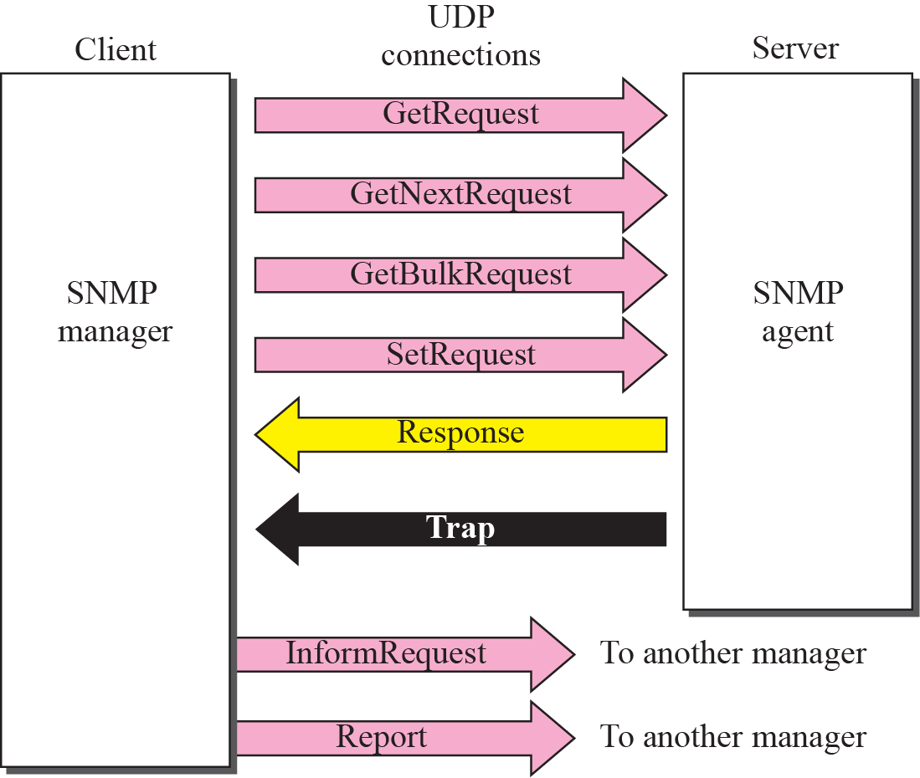
Figure 24.17 SNMP PDUs

Slide 16
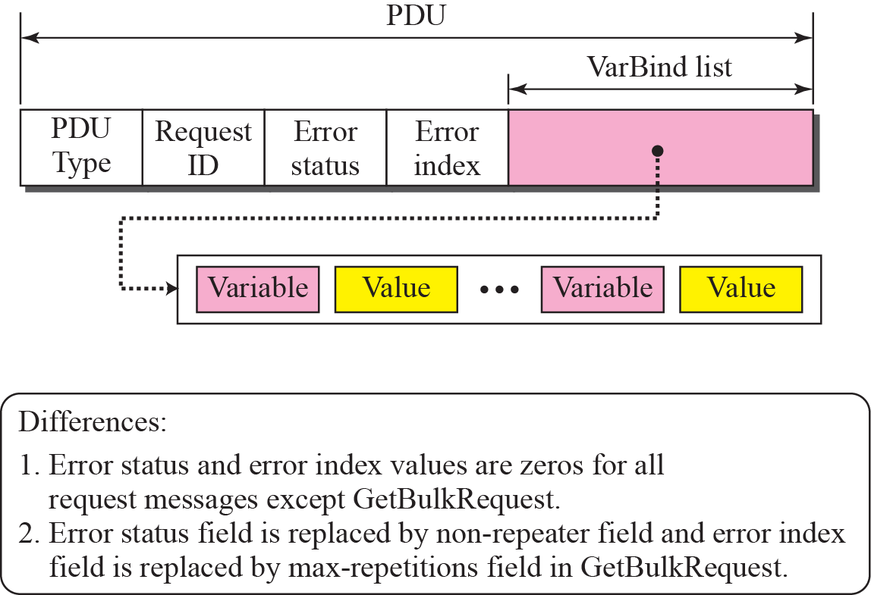
Figure 24.18 SNMP PDU format

Slide 19
24-6 UDP PORTS
SNMP uses the services of UDP on two well-known ports, 161 and 162. The well-known port 161 is used by the server (agent), and the well-known port 162 is used by the client (manager).

Slide 20
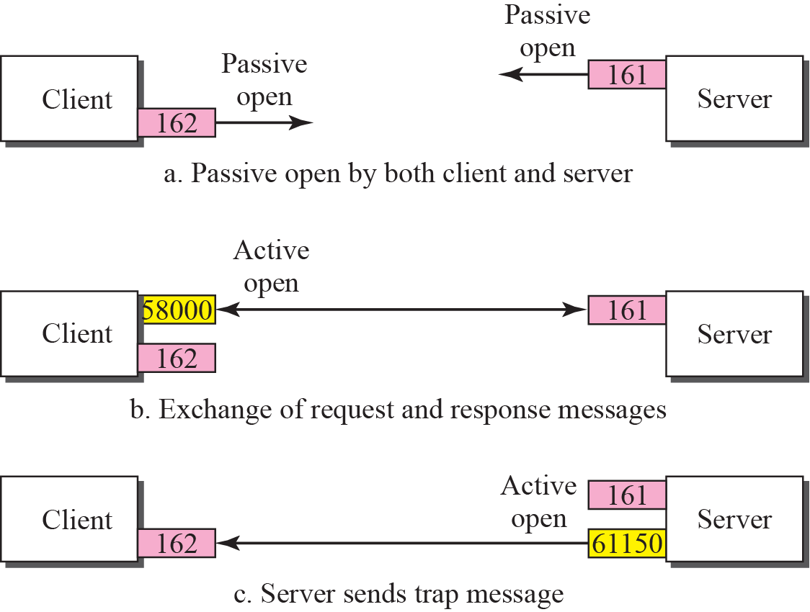
Figure 24.2 Port numbers for SNMP

Slide 21
24-7 SECURITY
SNMPv3 has added two new features to the previous version: security and remote administration. SNMPv3 allows a manager to choose one or more levels of security when accessing an agent. Different aspects of security can be configured by the manager to allow message authentication, confidentiality, and integrity.
SNMPv3 also allows remote configuration of security aspects without requiring the administrator to actually be at the place where the device is located.

